Slide 1
Explore Community Board 03
Xiaolong Li
XIAOLONG.LI@lc.cuny.edu

Slide 2

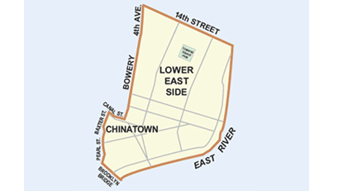
District Manager: Susan Stetzer
Board Chair: Gigi Li
Next executive Meeting ( Full Board meeting): December 22 6:30 pm at Public School 20, 166 Essex Street

Slide 3
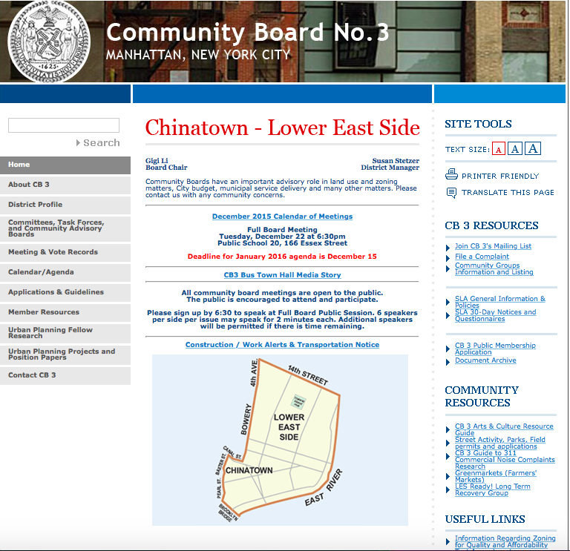
Community district digital footprint(Website)
Website: http://www.nyc.gov/html/mancb3/html/home/home.shtml
Key feature of the website:
i. Some significant information can be found from website.
ii. In SET TOOLS, TEXT SIZE can change the size of the whole website.
iii. Some useful resource, links can be found on homepage.

Slide 4
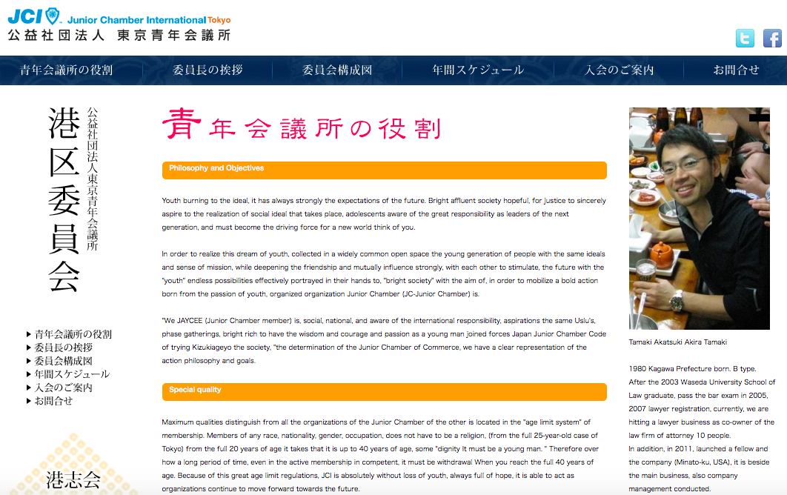
Community district digital footprint(Website)
Feature missing from the web site:
i. Board Chair’s message for people who live this board.
ii. A button or link to Facebook or Twitter (Which social media use not often at all).
iii. Another links for other community boards. ( In case people come to wrong board).

Slide 5
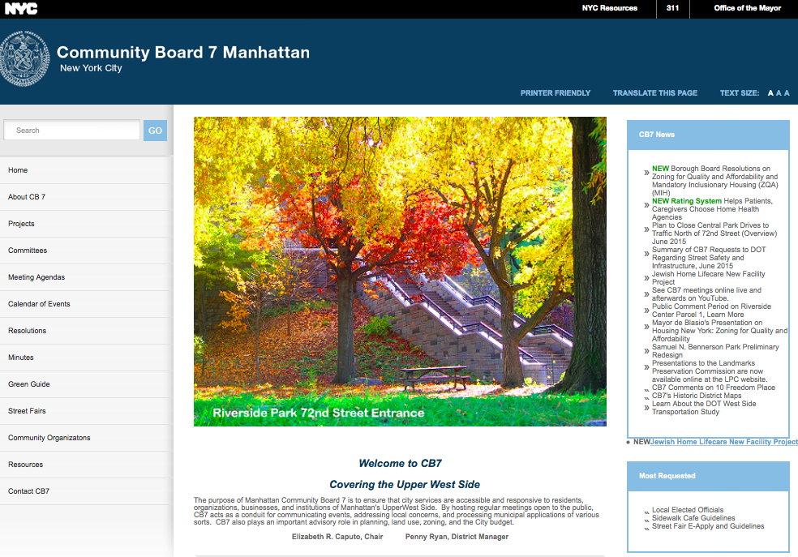
Good Example of community board website( Point: Picture)

Slide 6


Community district digital footprint(social media )

Slide 7
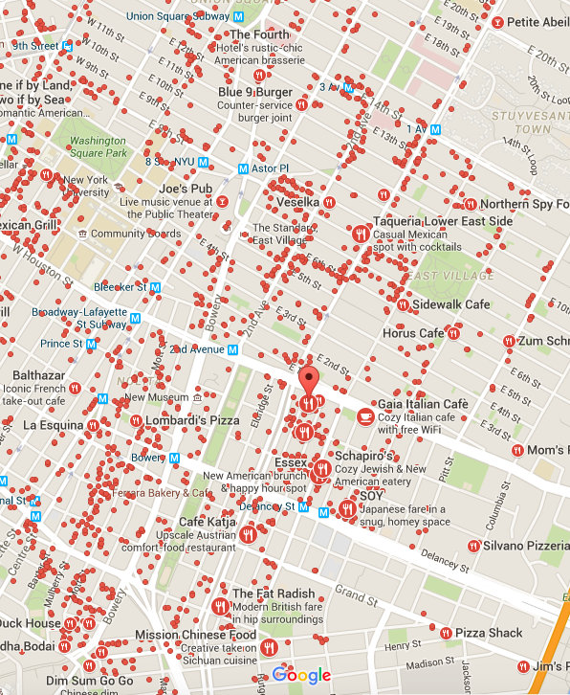
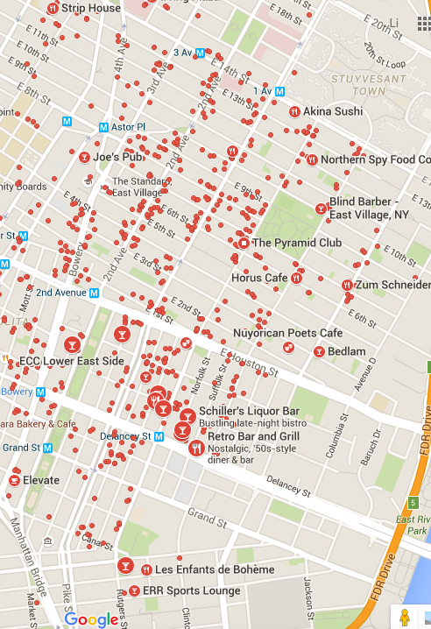
Restaurant map
Bar Map

Slide 8
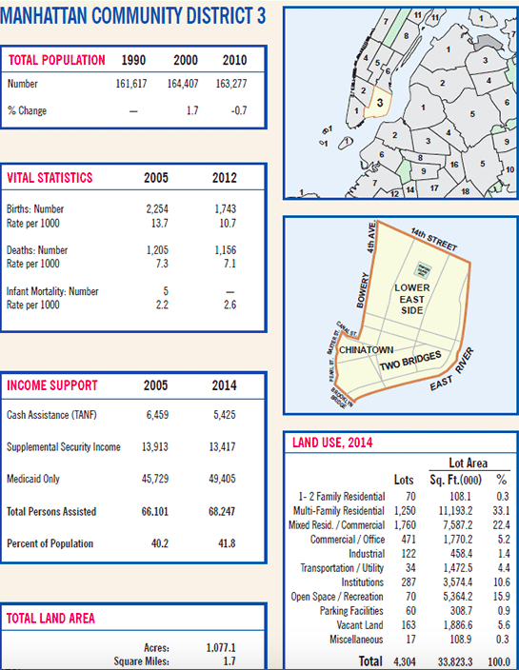
http://www.nyc.gov/html/dcp/html/neigh_info/mn02_info.shtml
The Most land
Use in Manhattan
By Residential and
Commercial
Combined Land
Use!

Slide 9
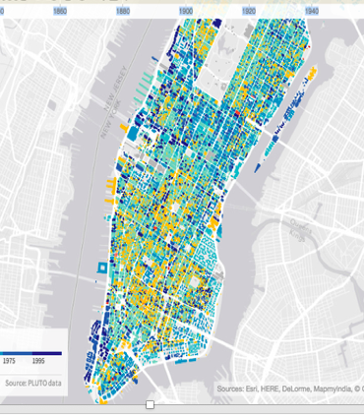
Explore the structure of CB03’s urban fabric
As color of CB03, there nearly 50%
are yellow( build over 100 years)
Souce: http://io.morphocode.com
/urban-layers/

Slide 10
Assumptions:
Winter: Hot water/Heating
Spring: Noise
Summer: Rat
Fall: Noise
(2012-2015) Winter
(2012-2015)Spring
(2012-2015)Summer
(2012-2015) Fall
Fact
Winter: Heating
Spring: Noise
Summer: Noise
Fall : Noise

Slide 11

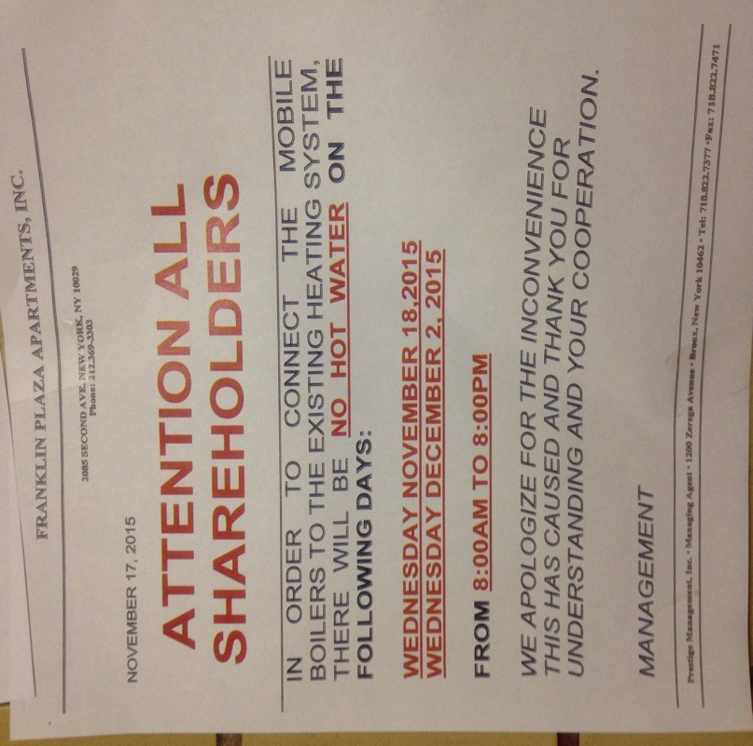
Heating/ Hot water Complaints

Slide 13
2012 Weather 2013 weather 2014 weather
From https://weatherspark.com/history/31081/2014/New-York-United-States

Slide 14
14 St, Avenue C, On October 29, 2012
Source: http://www.theatlantic.com/photo/2012/10/hurricane-sandy-after-landfall/100396/

Slide 15
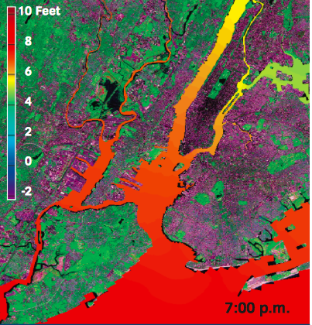
Sandy and Its Impacts
…More than 400 New York City Housing Authority buildings containing approximately 35,000 housing units lost power, heat, or hot water during Sandy…
http://www.nyc.gov/html/sirr/downloads/pdf/final_report/Ch_1_SandyImpacts_FINAL_singles.pdf

Slide 17
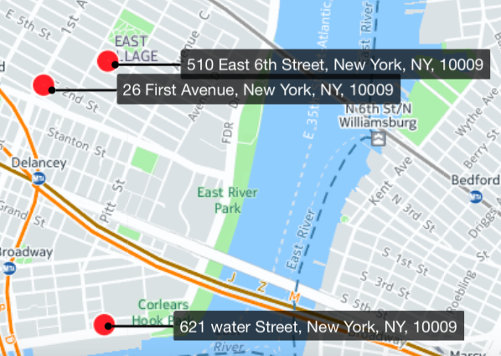
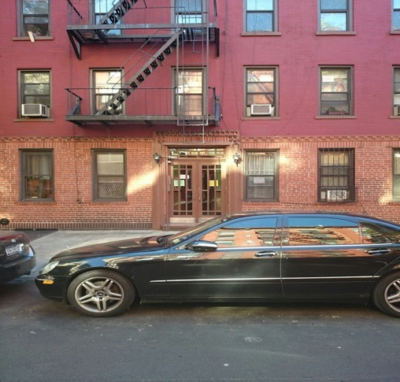
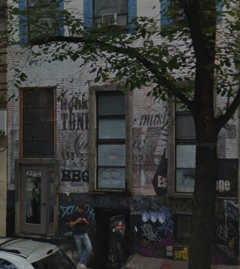
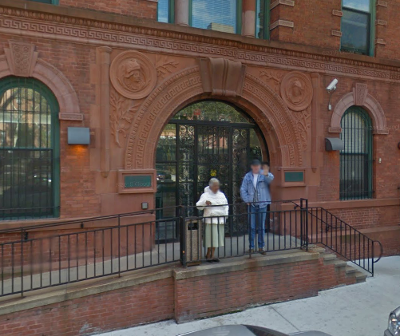
<TOP 3 Repeat caller >
510 E 6th Street(238 complains) 20 Units | 5 Stories | Built in 1900
26 1st Avenue (190complains) 20 Units 6 Stories Built in 1920
621 WATER STREET(156)
124 units 5 stories Built in 1901

Slide 19
What I Know From My Research…
Sandy happens
On October 29,
2012
Affect half an
year
(summer)May
and June
Still have heat
complains
-Sandy didn't affect too much.
Complains decreasing
The hypothesis: The next winter would
less

Slide 20
When these three spots call?
About these three buildings.
Which one more related on sandy
Which one is more constancy call
Which season they call?
4. Any story about these three budidings.

Slide 21
Repeater HOT WATER/HEAT top 10
1. 513 E 6th St. (240 ) (8 Units | 5 Stories | Built in 1920 )
2. 24 1st Avenue (190) (2 Units 3 Stories Built in 1900)
3. 621 WATER STREET (156) (124 units5 storiesBuilt in 1901)
4. 191 Avenue A(140 (9 units4 stories3 buildingsBuilt in 1900)
5. 239 Henry Street (129) (9 units5 storiesBuilt in 1900)
6. 153 Norfold St( 125)
7. 129 2nd Ave(107) (2 units6 storiesBuilt in 1900)
8.35 E 2nd St (104) (4 units6 storiesBuilt in 2003)
9. 197 Madison St(94) (20 units6 storiesBuilt in 1901)
10. 163 Orchard St(90) (12 storiesBuilt in 2009)
Map from: https://1491skdpf89.cartodb.com/viz/
48a8b144-978b-11e5-bf13-0e3a376473ab/public_map

Slide 22
Approve Assuption. ( Why this months are more rats during 7-10 month
Map
Restaurans
Ralated news
Anything to approve
Check the street scene (google)
Making all data Maps.

Slide 23
What I know from My Research…
Base on Data and graph
The weather doesn’t change the big differences of the amount of every year complains. The next year may would have the same amount of complains. If every year there are the same spots and same complains, does that mean, the city doesn’t work for the people who live there?
Hurricane Sandy Texted CB03 (NYC) not only heat/hot water system weakness, but like drainage system, Emergency system. What if there is another Sandy come, what should CB03(NYC) do?
From March 2014, 311 data changed the descriptor of complains types.
The most repeat callers complains are from old buildings.

Slide 24

Rat Problems

Slide 26
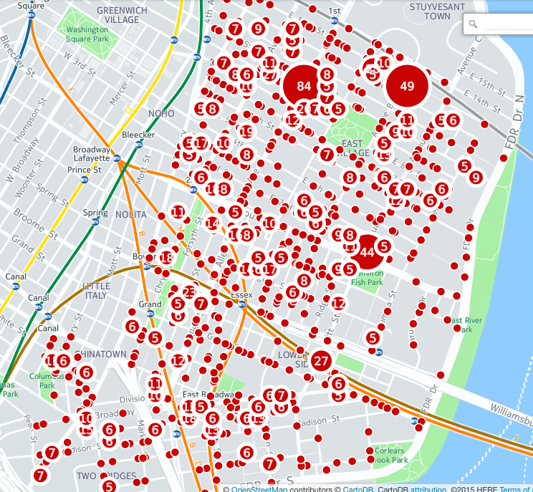
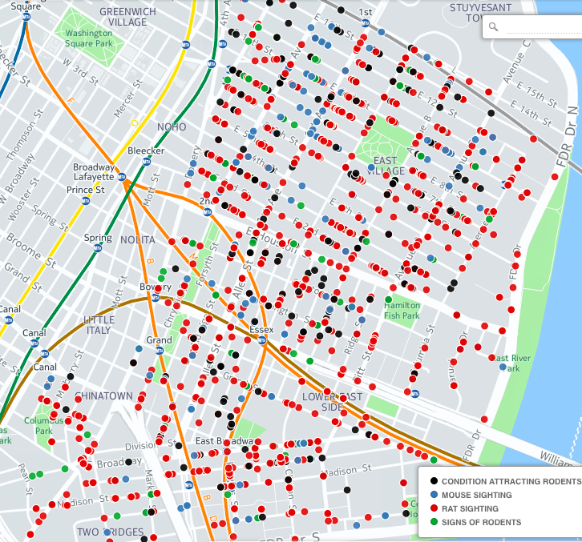
A
B
C
https://1491skdpf89.cartodb.com/tables/rodent_after2012_/map

Slide 27
2012-2015 CB 03 Rodent Frequency TOP 10

Slide 28
What I Know From My Research …
1. Background: Nightlife- heavy and restaurant-rich Chinatown. Food are more.
2. Reason summer, the food are abundant much more than other season
3. . From spring which the weather is getting warm, more rats , then summer is a pike time of Rats
4. Near October, because the temperature is getting colder or cooler, rats also have a good condition for growing up.
5. Solution Limit food abundant, the reason is rats, is always because food.
6. Control the rats at winter, then this will affect the whole year problems.

Slide 29
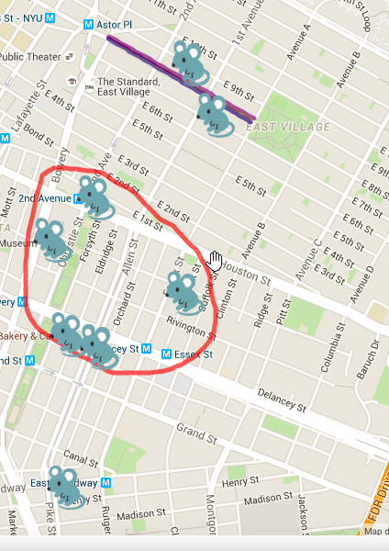
Map for top 10
http://www.scribblemaps.com/maps/view/Top_10_rats_complains_/CB03

Slide 30
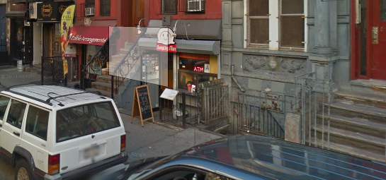
98 ST MARKS PLACE Method: Use posters use 311.

Slide 31
Street Condition

Slide 32
Cave- in and Defective Hardware are the big problems on 2012.

Slide 33
Cave- in and Defective Hardware are the big problems on 2013.

Slide 34
Cave- in Pothole are the big problme on 2014.

Slide 35
Cave- in and Defective Hardware, Pothole are the big problem on 2015.

Slide 36
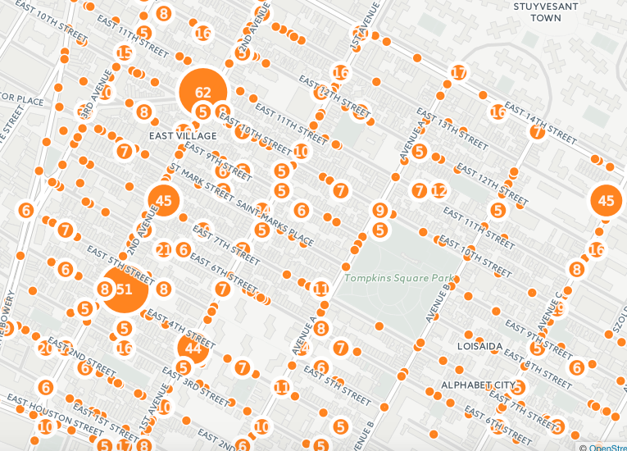
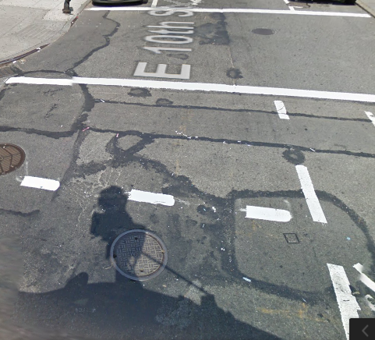
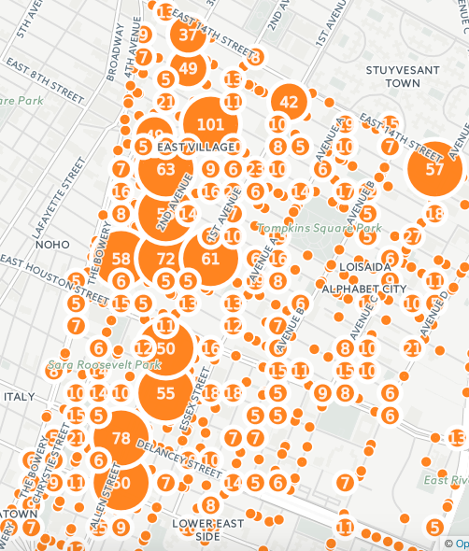
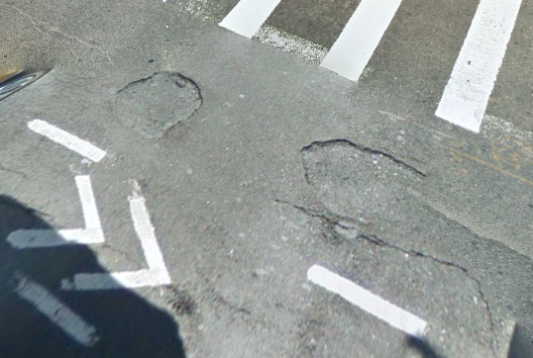
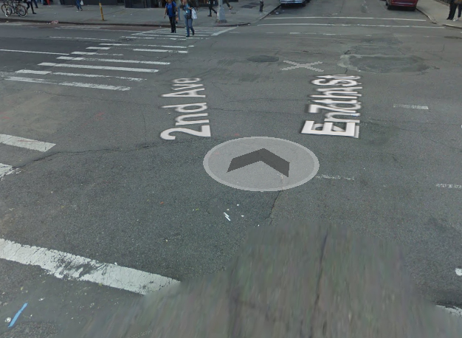
The seriously complains from area.
Source: https://1491skdpf89.cartodb.com/tables/street_condition_after_20112_to_present_copy/map

Slide 37
Change to 2015, Pothole is being a biggest issue in this community district.
Except Pothole.
In Winter, Defective hardware seem to be one of the most companied about issue.
In Spring, Defective hardware is still one of the most companied about issue.
In Summer, Cave-in is of the most companied about issue.
In Fall, Cave-in is of the most companied about issue.

Slide 38
What I know From My Research...
1. Top 5 street conditions:
Pothole
Cave-in
Blocked( construction)
Defective Hardware
Rough, Pitted or Cracked Roads
(These are ordered in descending order)
2.2015, Pothole is being a biggest issue in this community district:
Except Pothole Seasonal analysis:
In Winter, Defective hardware seem to be one of the most companied about issue.
In Spring, Defective hardware is still one of the most companied about issue.
In Summer, Cave-in is of the most companied about issue.
In Fall, Cave-in is of the most companied about issue.

Slide 39
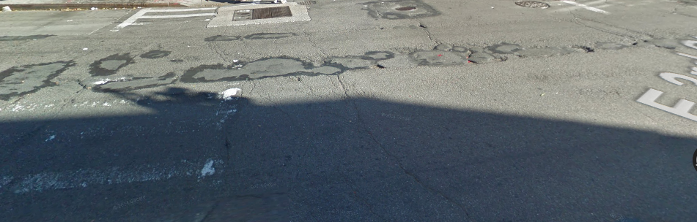
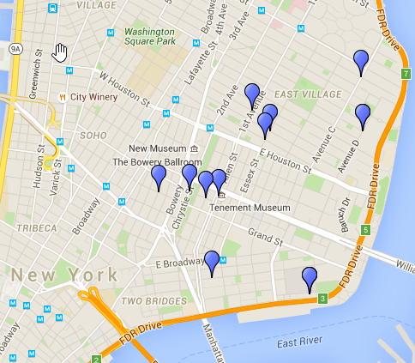
Pothole instance- 3th Street Avenue A
https://goo.gl/maps/KGjhH4UXCSt
Map for Pothole : http://www.scribblemaps.com/maps/view/Top_10_Pothole/CB03-4

Slide 40
Noise

Slide 42
Noise Hot spots (top 10)
1.

Slide 43
Repeater Caller( top 10)

Slide 44
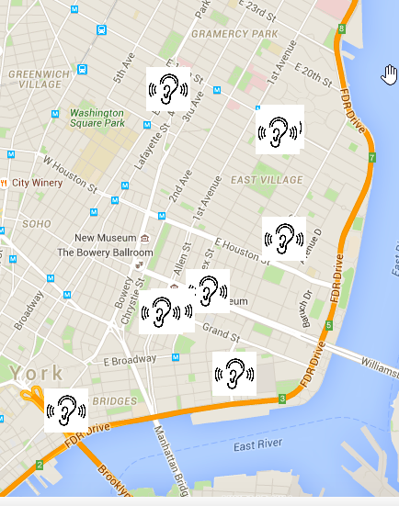
Top 10 Repeater’s map
324 Grand St
35 Montgomery St
http://www.scribblemaps.com/maps/view/Repeaters/CB03-3

Slide 45

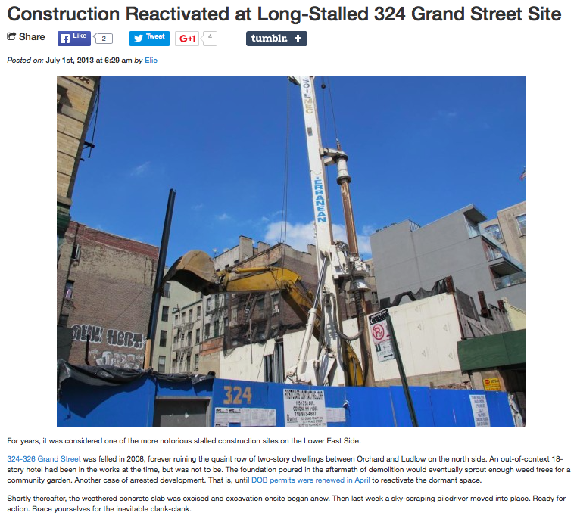
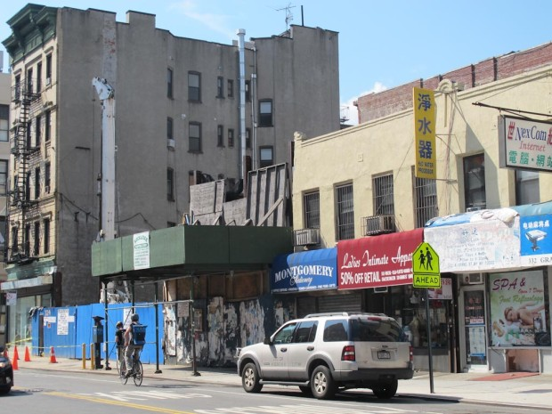
News Related to nosiest location

Slide 46
What I know From My Research…

Slide 47
Illegal Parking

Slide 48
The top 5 complains in the most complained about locations

Slide 49
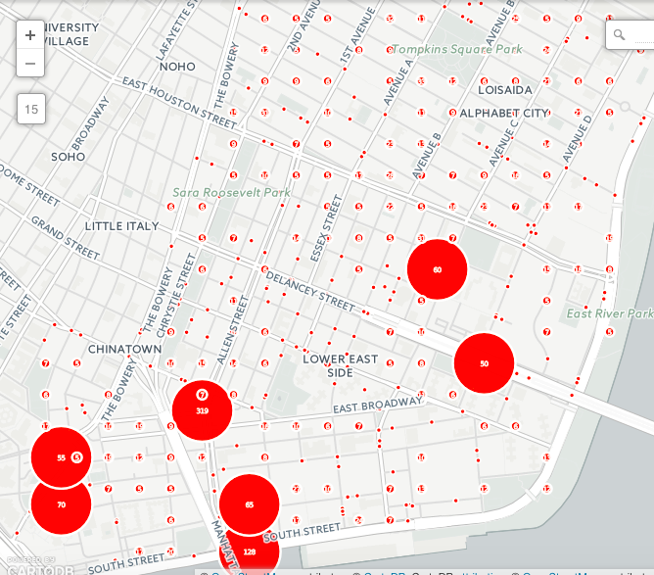
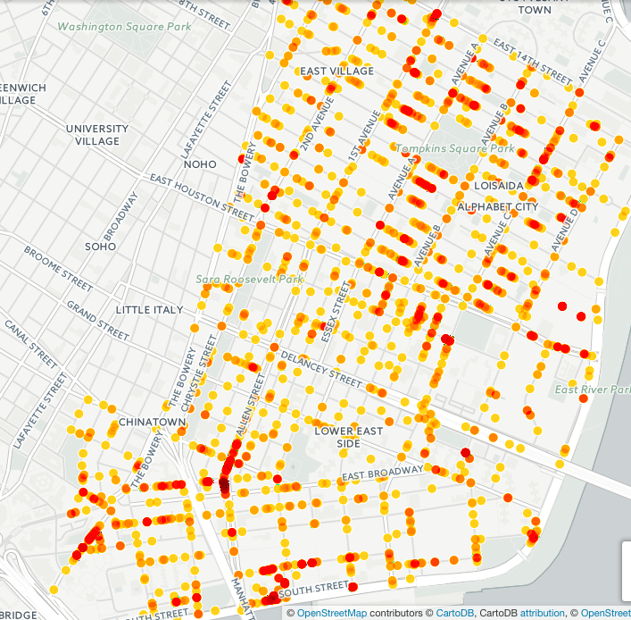
The most illegal Parking( Include everything) Areas Complains come from…
https://1491skdpf89.cartodb.com/tables/illegal_parking_after_2012_to_present_/map

Slide 50
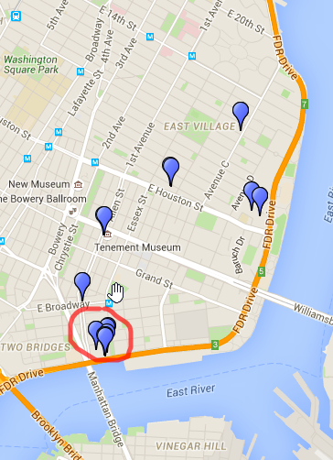
Hot spots are:
http://www.scribblemaps.com/maps/view/Top_10_illegal_parking/CB03-2

Slide 51
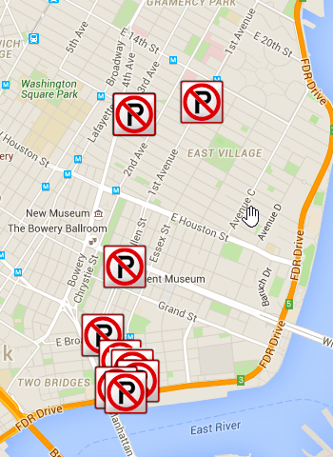
http://www.scribblemaps.com/maps/view/Top_10consistency/CB03-5

Slide 52
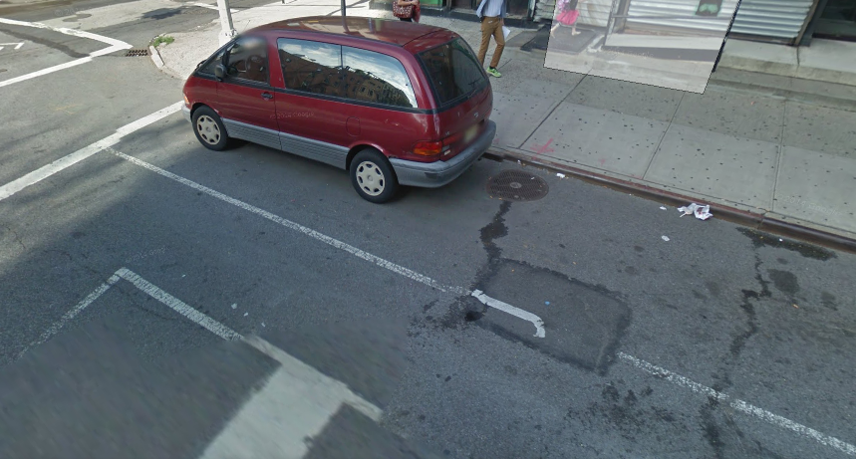
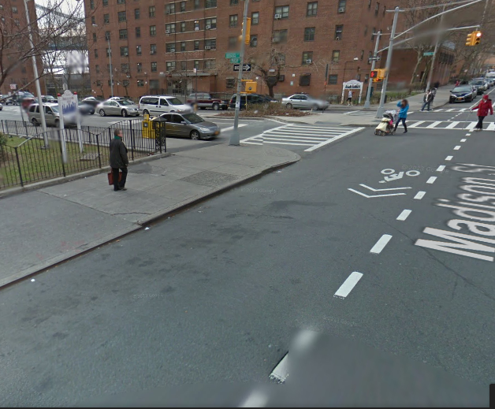
Street Scene for constancy illegal parking 165 Ave C 80 Rutgers St
From Google Street Scene

Slide 53
What I know From My Research :

